Slide 1

NEWS APP
MADE BY
PRIYANKA SARAYAN
NITIN MAGDUM
RAJA DHURAI

Slide 2
OUTLINE
Problem Statement
Objective
Microservices
Project Overview
Architecture
Application Flow
Technology Used and snapshots of app
Conclusion

Slide 3
PROBLEM STATEMENT
A person wants to stay updated with latest news anywhere anytime.

Slide 4
OBJECTIVE
Our aim is to provide user friendly experience by providing latest news.
01
It also has customization benefit where users can add news into the favourites list and view them from anywhere, anytime.
02
Further, news are also categorized into sports, entertainment and many more for easy searching.
03

Slide 5
MICROSERVICES
Authorization
Favorites
NewsAPI

Slide 6
PROJECT OVERVIEW
+
LOGIN
USER
AUTHORIZATION
FAVORITES
NEWSAPI
HOMEPAGE
REGISTER
SEARCH NEWS
MONGODB
MONGODB
CLOUD API
NewsAPI

Slide 7
ARCHITECTURE
AUTHORIZATION API
JWT VALIDATOR
MONGODB
POST
LOGIN/REGISTER
FAVORITES API
Adding to favorites
Watching favorites
Deleting from favorites
MONGODB
FRONTEND
GET/DELETE/POST
GET/DELETE/POST
NEWSAPI
Search news Getting news by category
CLOUDAPI
GET/POST

Slide 8

PROJECT FLOW
HOME
REGISTER
LOGIN
ADD TO FAVORITES
USER
VIEW FAVS
DELETE FAVS
UPDATE PROFILE
VIEW NEWS
VIEW NEWS ACCORDING TO CATEGORY

Slide 9







TECHNOLOGIES USED

Slide 10
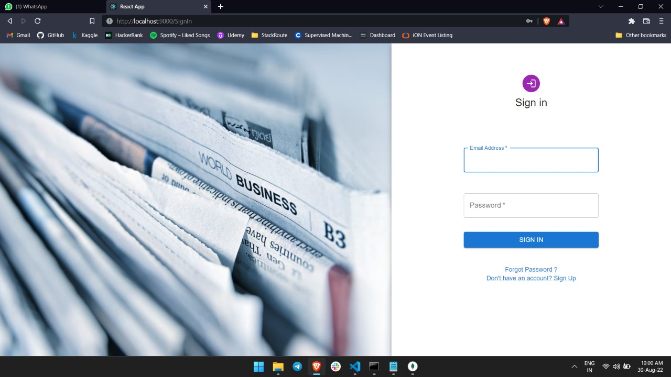
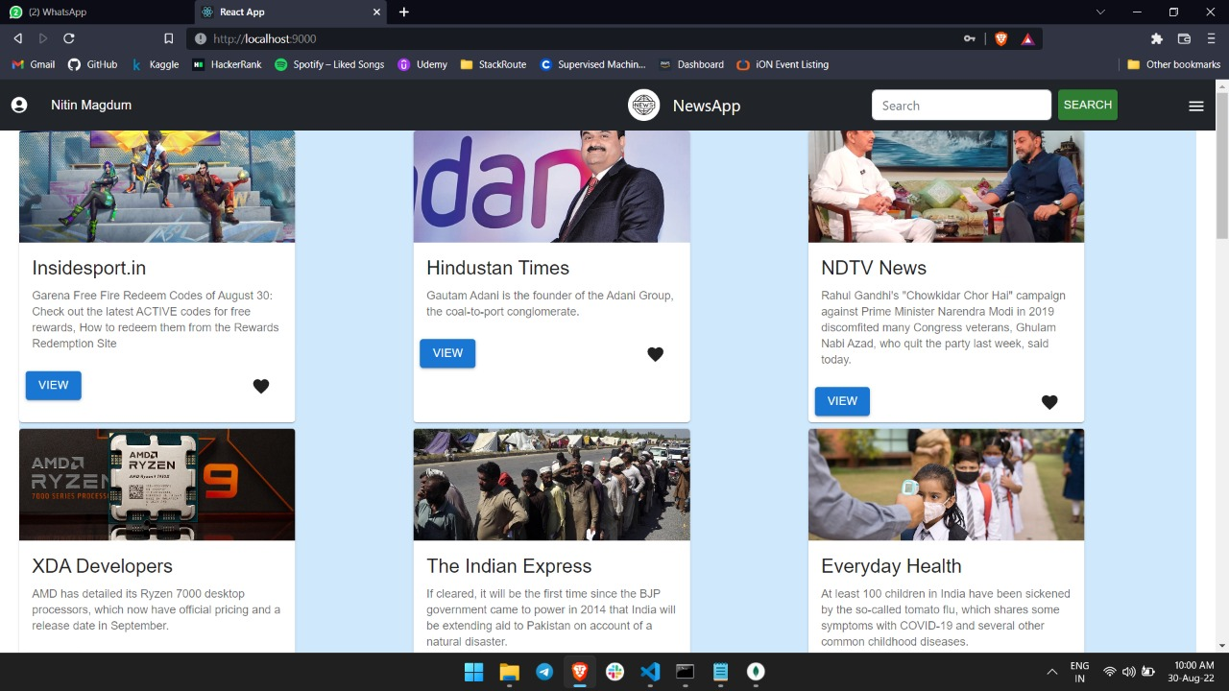
SNAPSHOTS OF THE APPLICATION

Slide 11
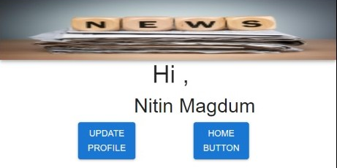
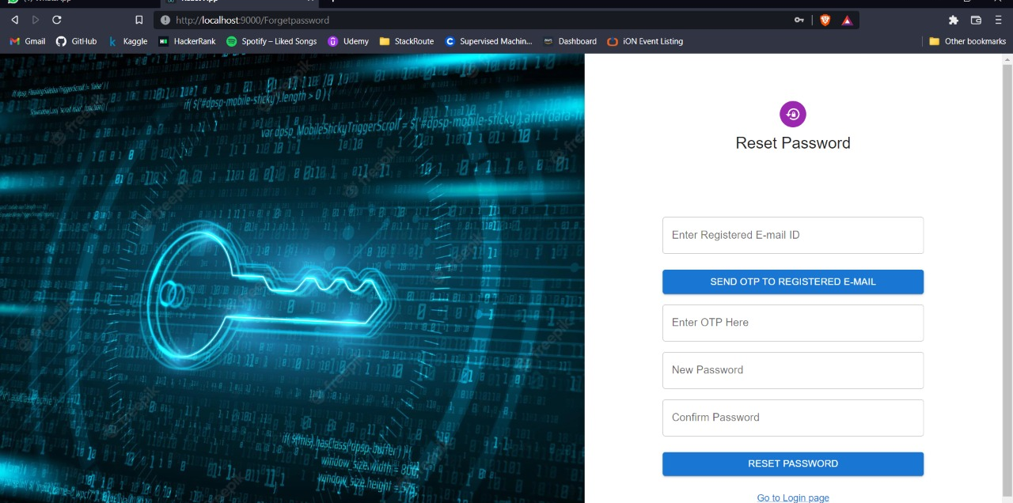
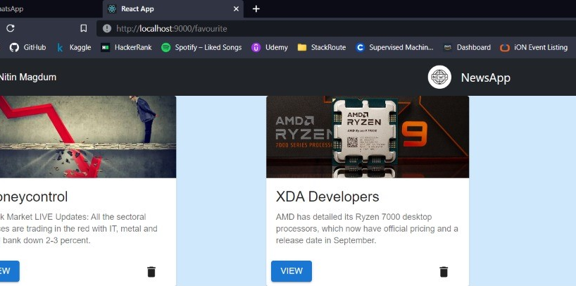
SNAPSHOTS OF THE APPLICATION

Slide 12
CONCLUSION
The News app helps the user to read news online.It also helps the user to add news as favorites for future reference.
It can be accessed anytime, anywhere as per user's wish.

Slide 13

Future Scope

Slide 14


